Slide 1
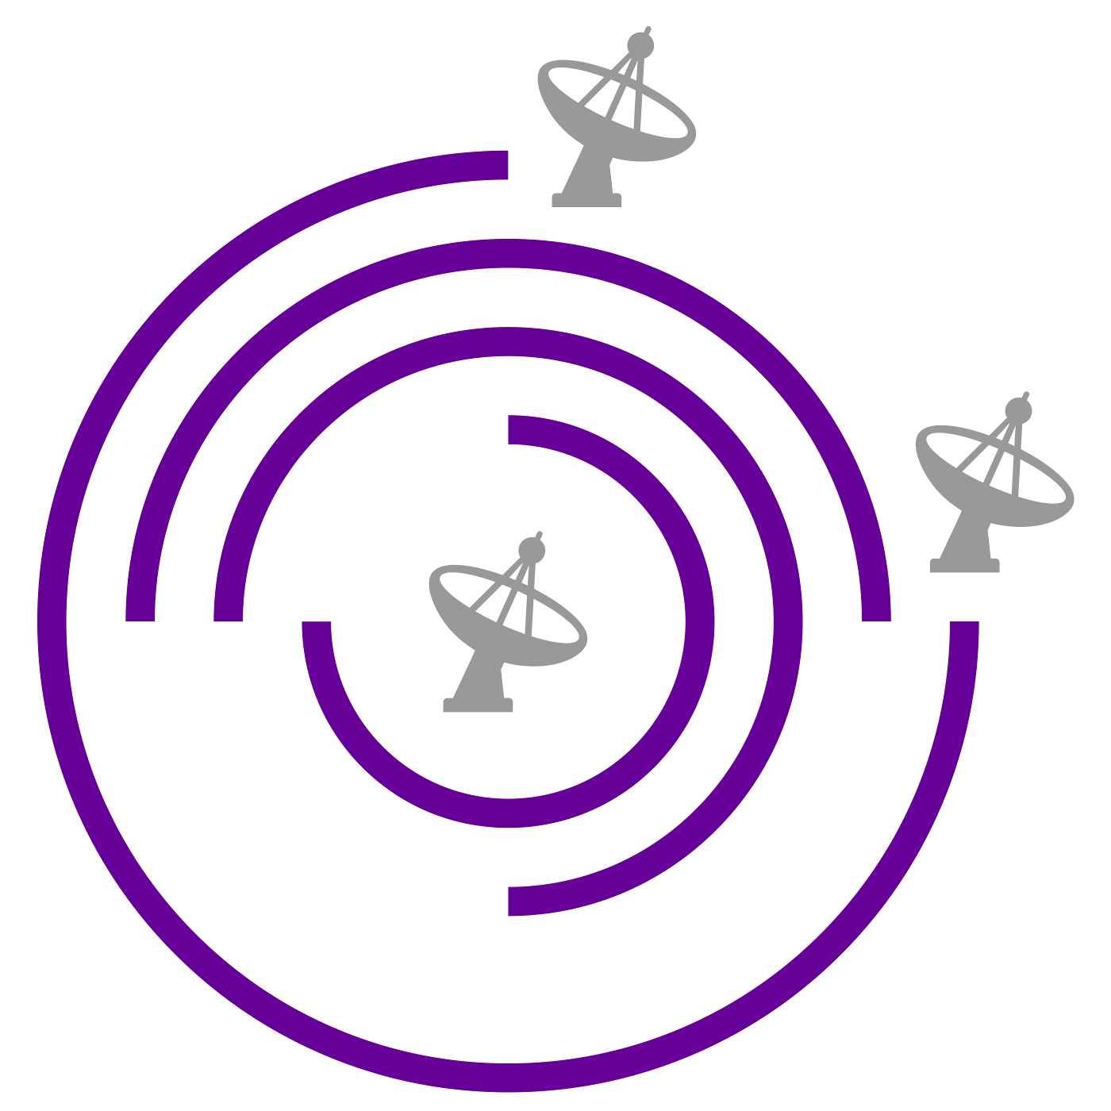
Interferometer fundamentals
Adam Avison

Slide 2
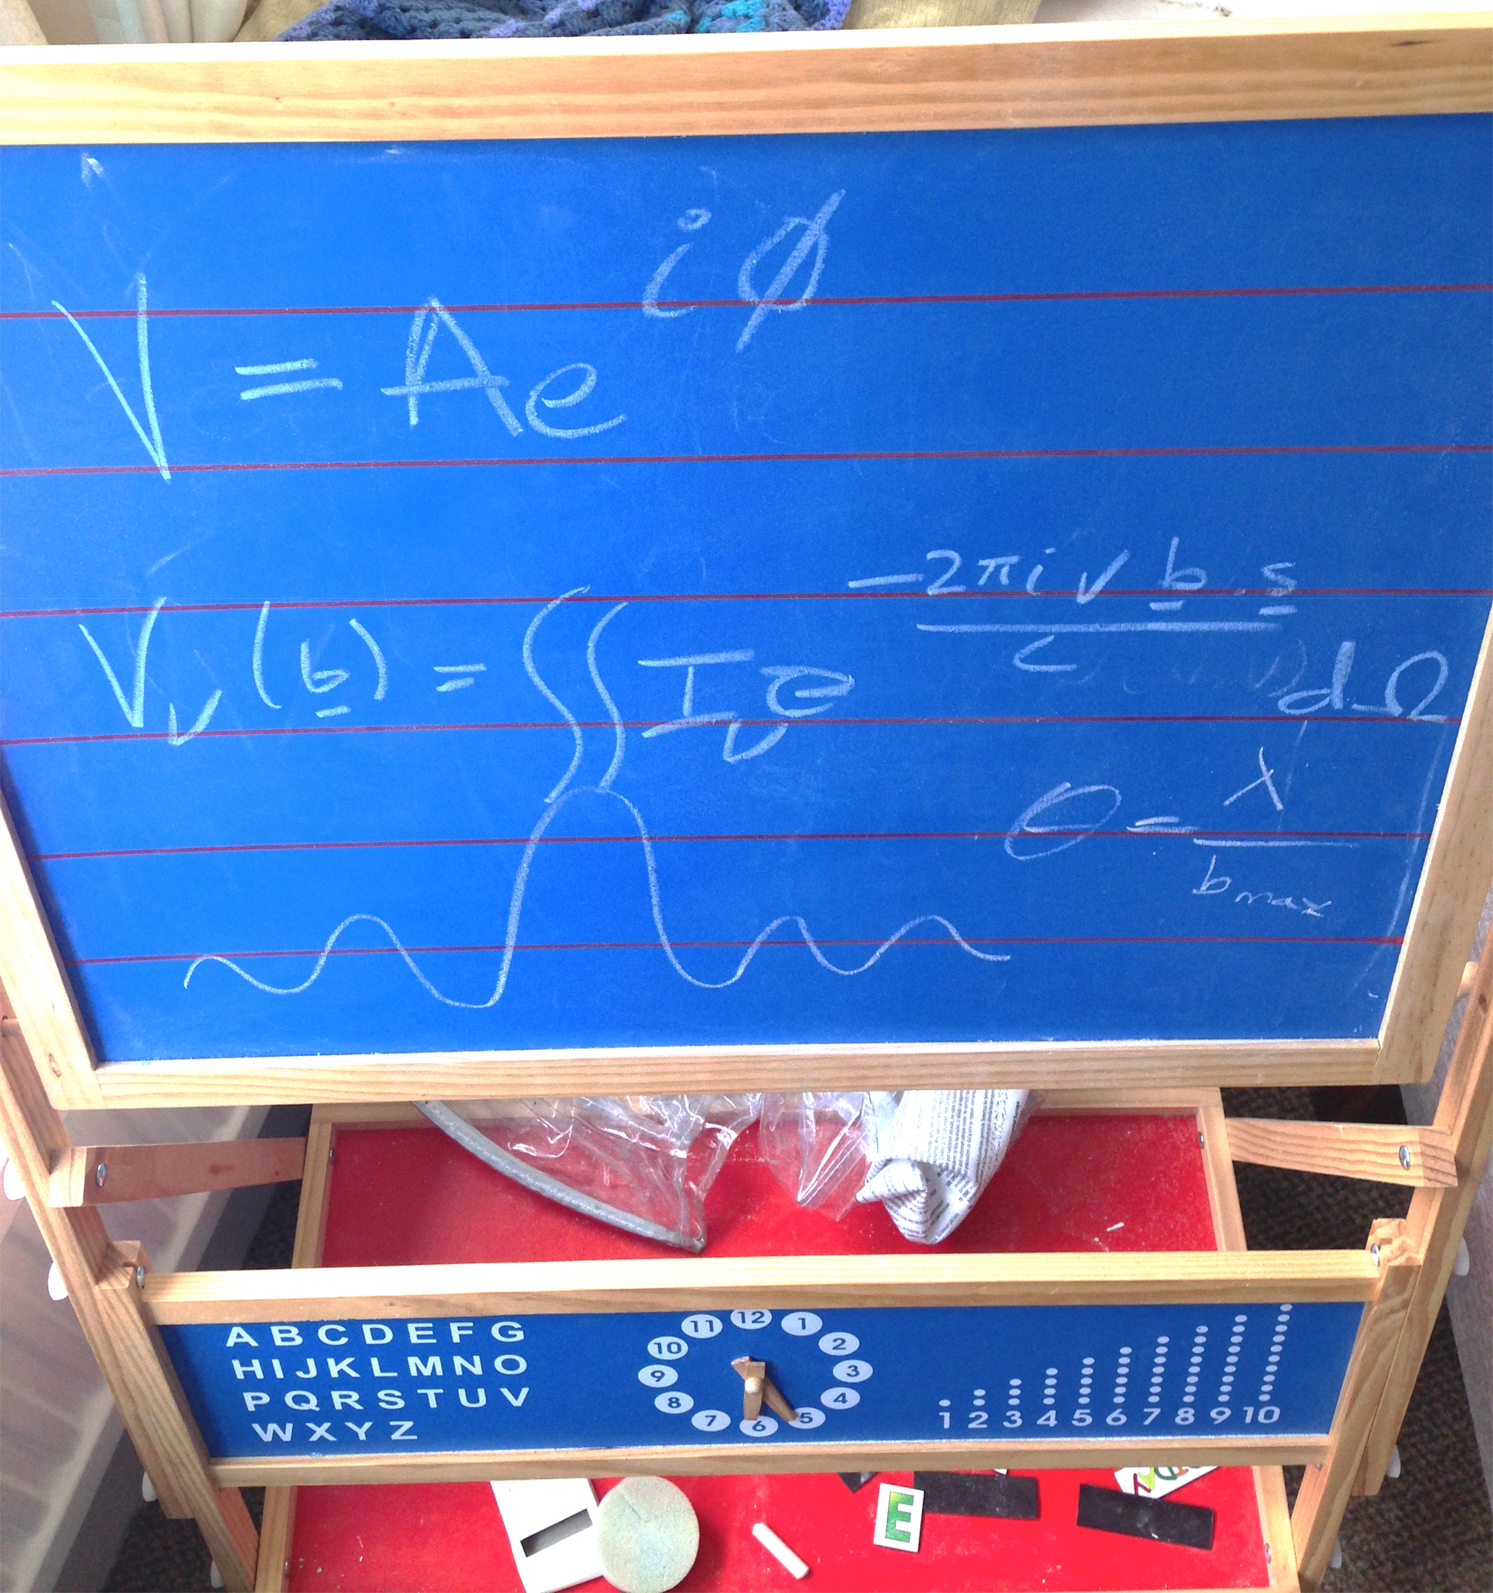
Outline
Why use an interferometer?
Two element interferometer
uv-coverage
A bit on calibration
Imaging data and Cleaning

Slide 3
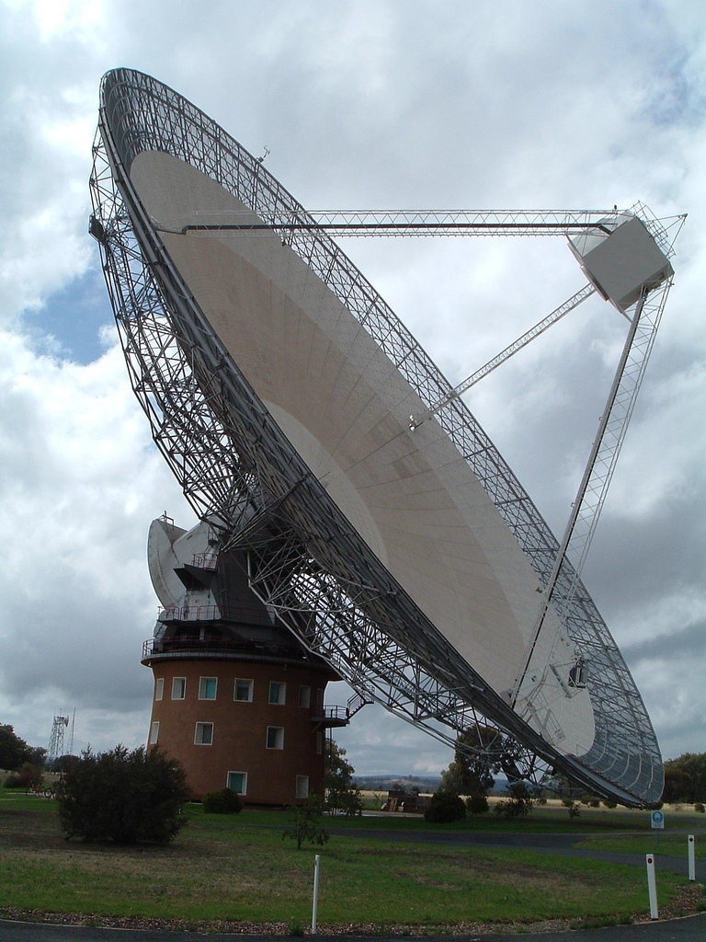
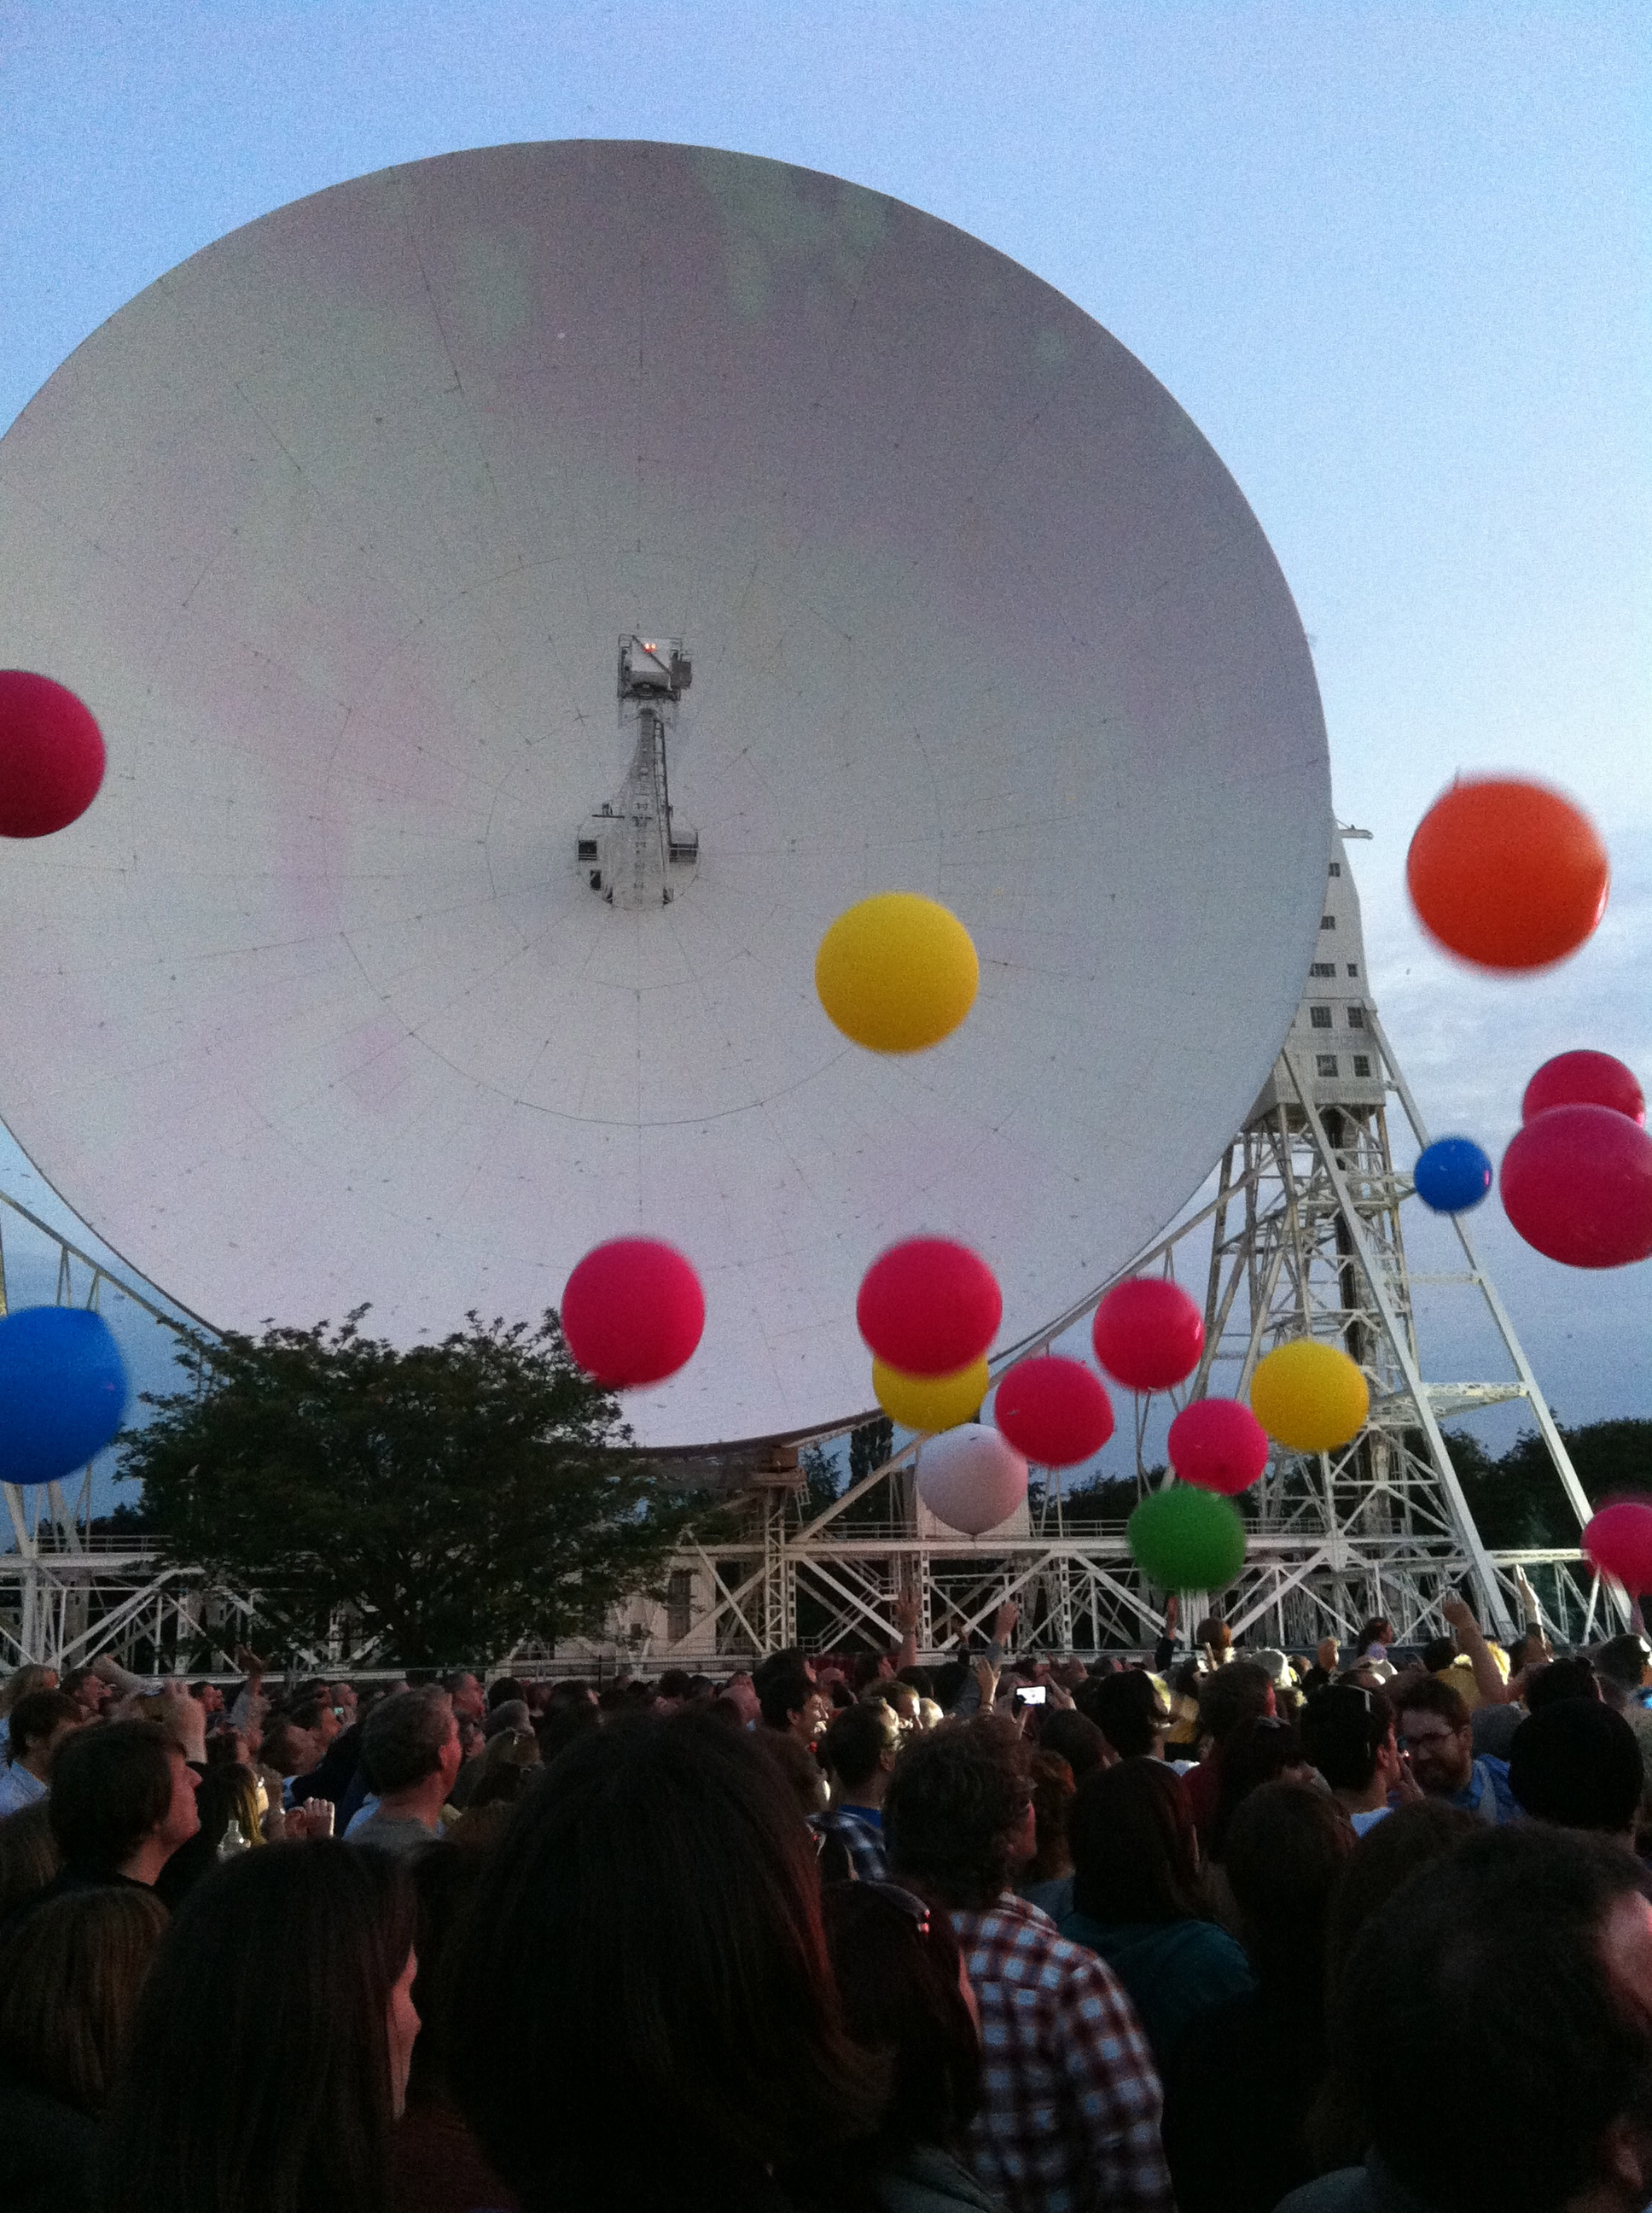
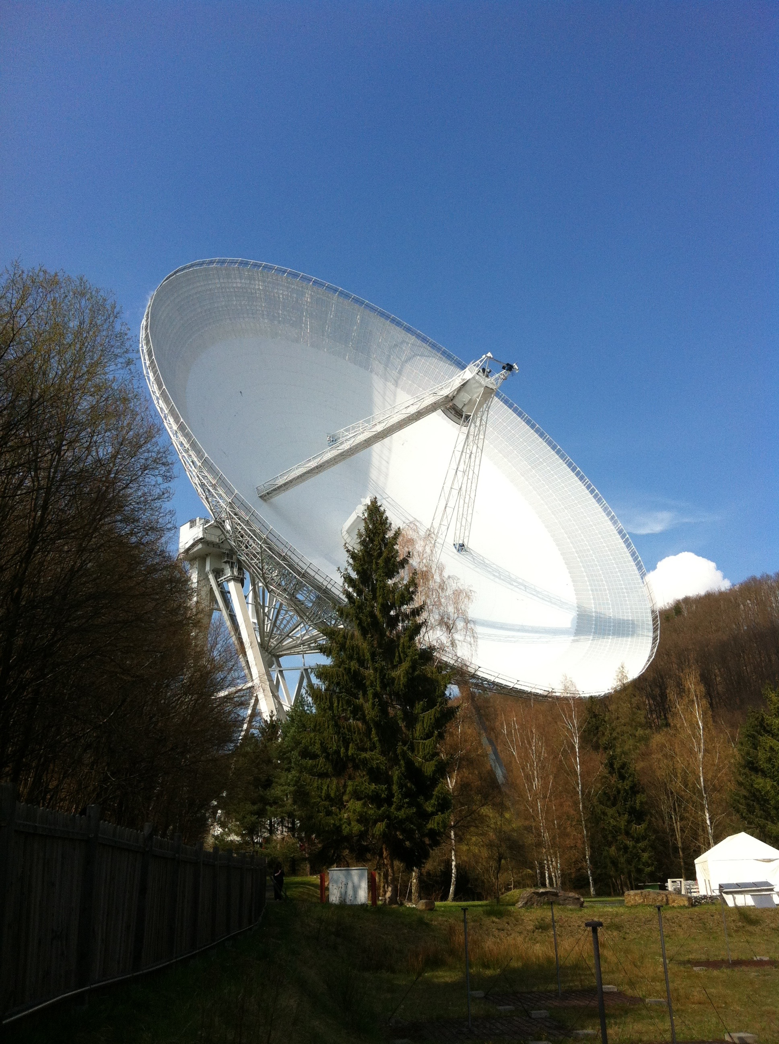
Why use an interferometer? - What do astronomers want?
High resolution
High sensitivity
Parkes 64m
Lovell 76m
Efflesburg 100m
Notes:
Astronomers want everything... BIG DISHES REQUIRED

Slide 4
Resolution
Sensitivity
Imagine we want Hubble resolution:
D=2.4m, λ=600nm -> θ=0.05arcsec
At radio wavelengths, say 4.5cm (6.7GHz):
D would need to be ~185km
Basically, the bigger the better!
Effective area of your dish

Slide 5
How do we get it?
Interferometry
ALMA, 54 12m dishes and 12 7m dishes spread over 14km

Slide 6
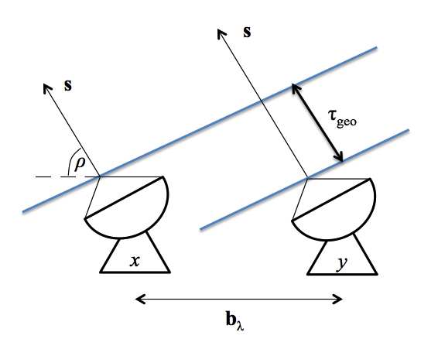
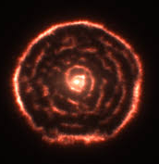
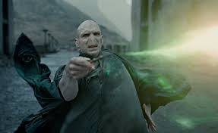
Most peoples first impression of interferometry
Dark Arts
Dishes
Pretty pictures
... hopefully by the end of this hour we’ll have cleared up the bit in the middle

Slide 7
The two element interferometer

Slide 8
The two element interferometer
What are we trying to do?
- Recreate the sky brightness distribution of astrophysical sources.
Delay between wavefronts arriving at x then y:
Receiver outputs
Correlator’s function
Do the maths
Correlator output
Notes:
So the cross correlation of the two antenna outputs is the product of the correlator.
Equivalent to the multiplication of the Fourier transform of X times y’s fourier complex conjugate
cross-correlation is a measure of similarity of two series as a function of the lag of one relative to the other.

Slide 9
That’s all well and good but how does this
tell us anything about the sky brightness distribution?

Slide 10
...
v₁ and v₂, the voltage outputs of x & y are directly related to:
The brightness distribution, I(s), of the astronomical object
as seen over solid angle dΩ
and A(s) the area of the dish we use to observe it.
Leading to ...
Notes:
Delta nu is a bandwidth term becase recievers don’t observe at a single frequency

Slide 11
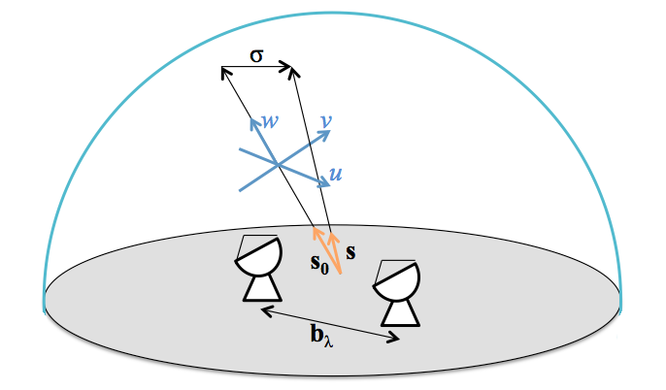
Adding in a bit more reality...
The vector s is comprise of the addition of s₀ and σ (so s=s₀ +σ).
We set τ_{geo} to zero with instrumental delays
Meaning all delays in the data are from the vector σ
We then define the Complex Visibility as:
which is rather nice as V is the Fourier transform of I.
Notes:
Sorry to switch from trig to exponential forms here but it just makes sense to me.

Slide 12
Relating the visibility equation to the correlator output gives
Known!*
* After proper calibration

Slide 13
A coordinate system for interferometry
We define u and v, as E-W and
N-S positions w.r.t w axis which
is parallel to s_{0.}
l and m as direction
cosines of s we can write the
visibility equation as:
l
m
Given l and m are small the small angle approx applies and V(u,v) becomes a
direct Fourier transform of I(x,y)
Notes:
Direction cosine = angle between vector s and s0 to the uv plane.
Remember we have one of these PER BASELINE

Slide 14
In its full gory glory the... Measurement Equation
V_{ij} = What we measure
I_{ν} = What we want
Q_{ij} = additive errors
S = maps I to polarisation
i,j = telescope pair
M_{ij} = Multiplicative baselines errors
B_{ij} = Bandpass reponse
G_{ij} = Gerenalised electronic gain
D_{ij} = polarisation leakage
E_{ij} = Antenna voltage pattern
P_{ij} = paralatic angle
T_{ij} =Tropospheric effects
Green= vectors
Blue= Scalars
Red= Part of the Jones Matrix
Slide cribbed from A.M.S.Richards
Notes:
As used by CASA

Slide 15
What we measure
Correlator output
Eq. 1
Visibility equation
Eq. 2
$$I^{D}\left(l,m\right)=\iint_{−∞}^{∞}{S\left(u,v\right)V\left(u,v\right)e^{2πi\left(ul+vm\right)}dudv}$$
Dirty image
Eq. 3
Notes:
The greater the number of UV points the greater our knowledge of I

Slide 16
uv-coverage

Slide 17
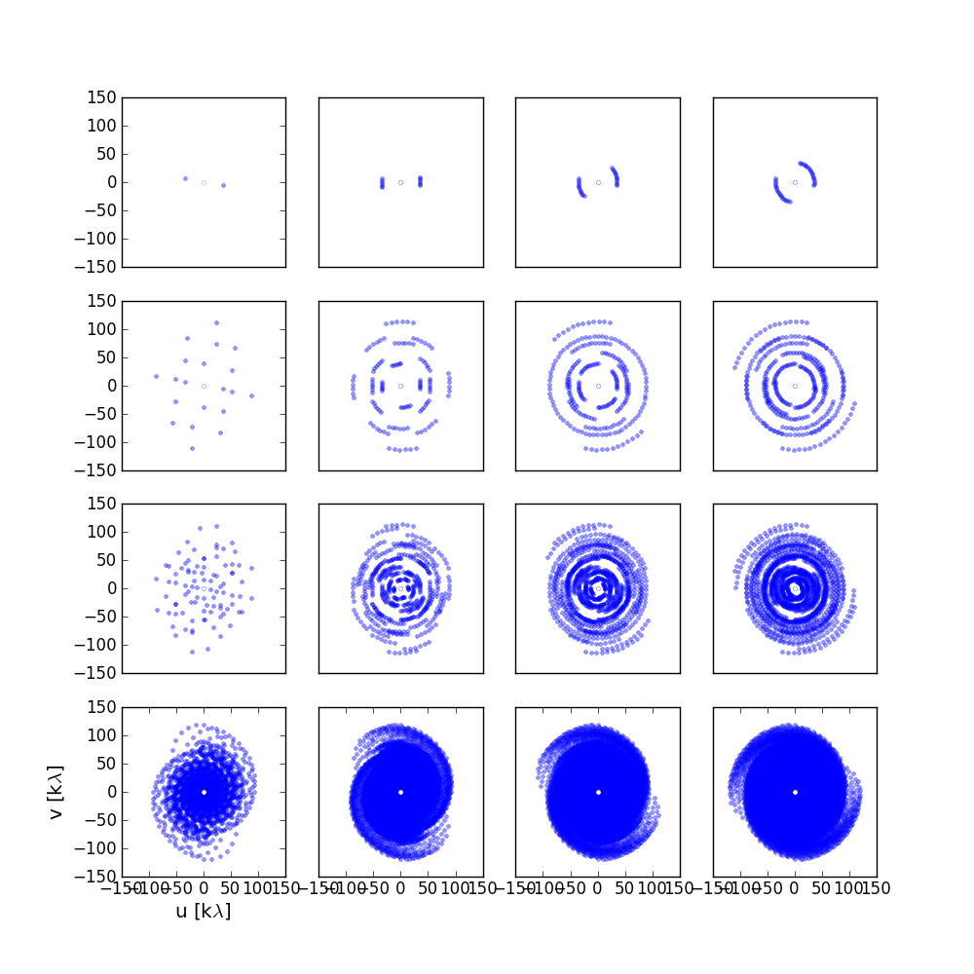
Filling the uv-plane
t = 10s 2h 4h 6h
N_{ant} =
2
5
10
50
uv-coverage of an interferometer set out in a logarithmic spiral pattern comprised of two, five, ten and fifty antennas (top to bottom) and observing for 10 s, 2, 4, and 6 h (left to right).

Slide 18
ASIDE: Antenna spacing to u, v, w
L_{x}, L_{y}, L_{z} = antenna coordinate differences
H₀ , δ₀ = hour-angle and declination of the phase reference position
λ = central frequency of observation

Slide 19
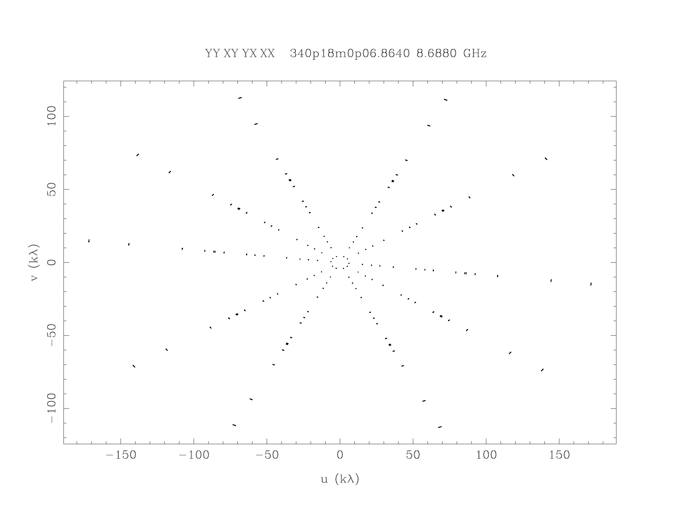
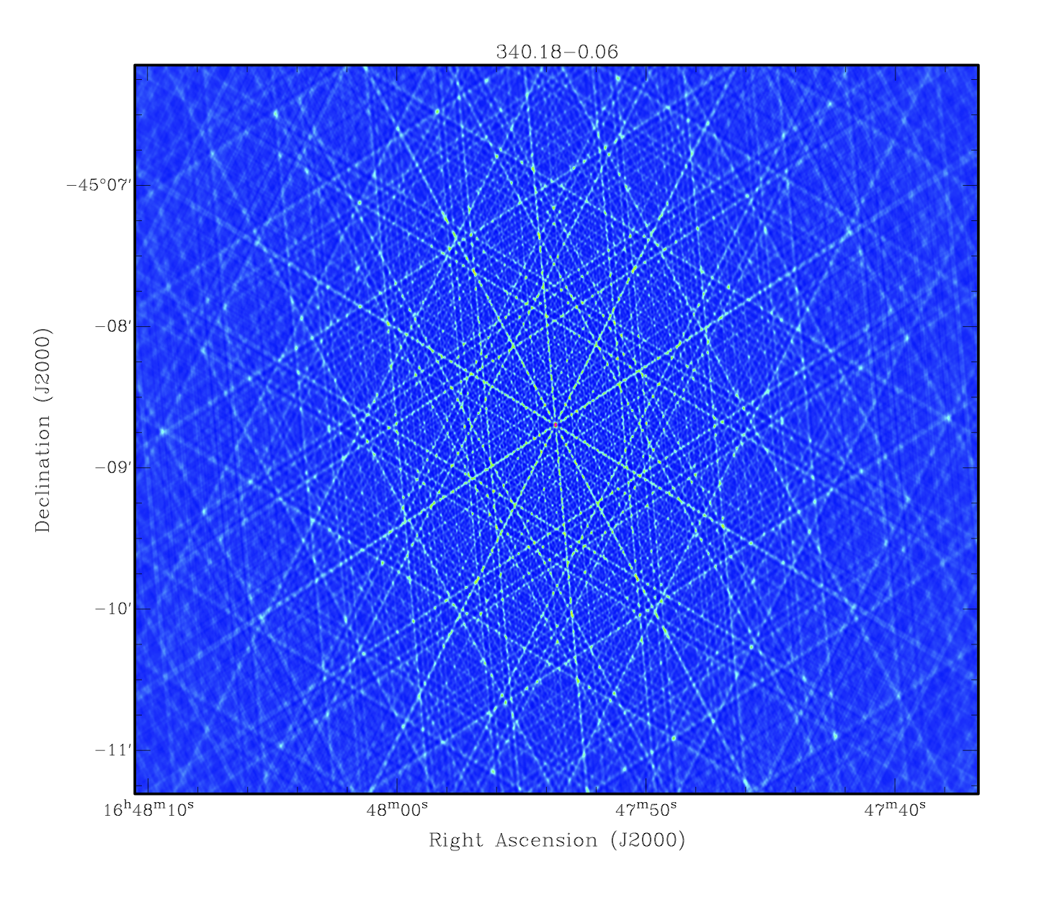
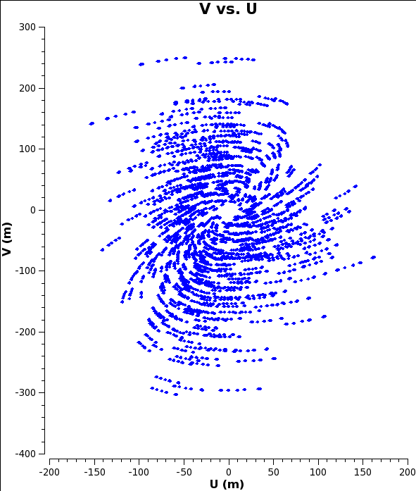
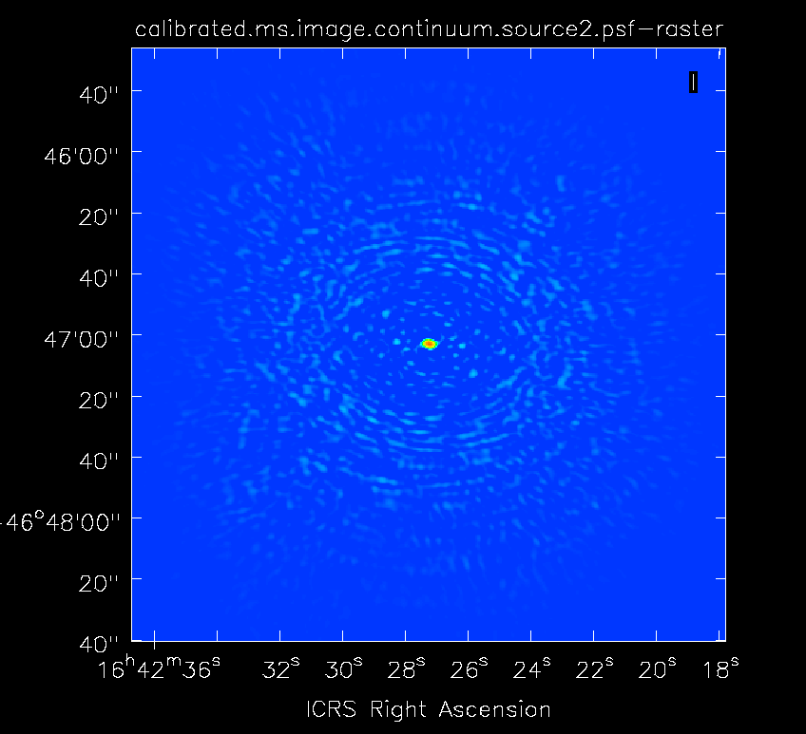
Filling the uv-plane
We want to fill the uv-plane because the uv-coverage is the FT of the
synthesised beam, B. The greater the uv-coverage the better behaved the sidelobes are.
6 dishes
(~15 mins)
42 dishes
(~15 mins)

Slide 20
Filling the uv-plane
For each antenna pair at each integration interval we get one uv measurement.
To optimize uv-coverage, thus giving us a ‘nicer’ synthesized beam we would ideally have:
1) A large number of dishes, thus more antenna pairs (N(N-1))
2) Greater time on source, more uv-points from the antennas we have.
3) An array configuration with a larger number of unique antenna spacings.

Slide 21
Visual example

Slide 22
A bit about calibration...
Notes:
Not going to go into detail because it is kind of telescope dependent.

Slide 23
All interferometers have the following steps in common.
Apriori steps. Some selection of system specific steps which need taking into account before standard calibration. We’ll ignore these
Bandpass calibration
Flux calibration
Gain calibration / Amp & phase calibration
Notes:
1) E.g. for ALMA WVR, Tsys etc.

Slide 24
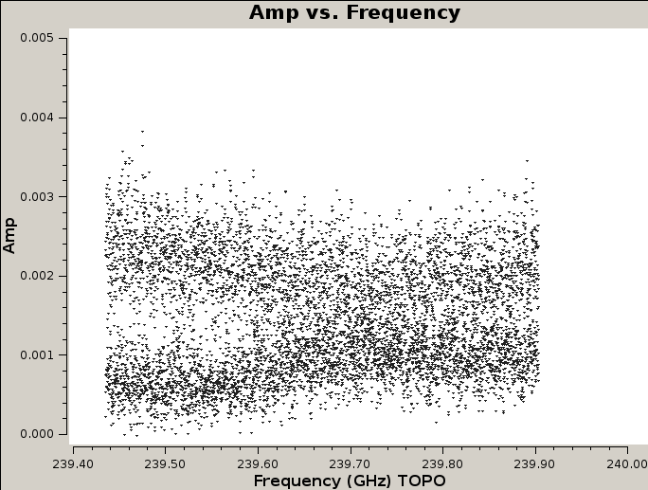
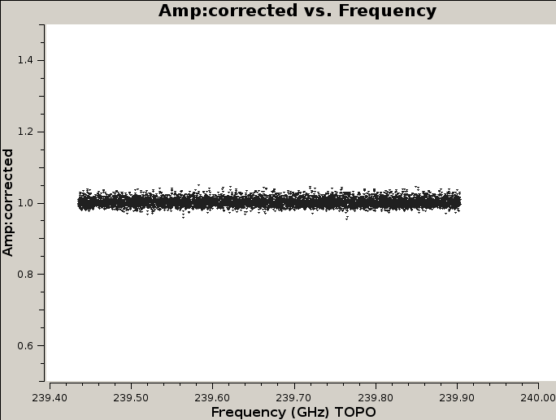
Bandpass calibration
Antenna based calibration. So solutions are per antenna w.r.t reference antenna.
Each receiver will have a unique response to emission at a given 𝜈.
But we know our BP cal has a flat spectrum (or known spectral index).
Calibrator needn’t be close to target on sky.

Slide 25
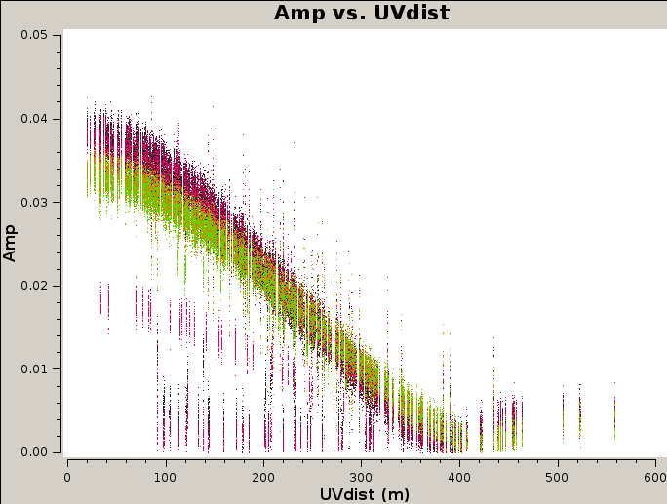
Flux scaling
The visibility amplitudes which come out of the correlator have an arbitrary scaling.
To convert these into physically meaningful values we observe a source of known flux to which we can “bootstrap” the amplitudes values to.
Calibrator needn’t be close to the source. (But should avoid being low in the sky).
ALMA data of Titan for a given dataset (some bad
data here!).
Y-axis scale in correlator output units

Slide 26
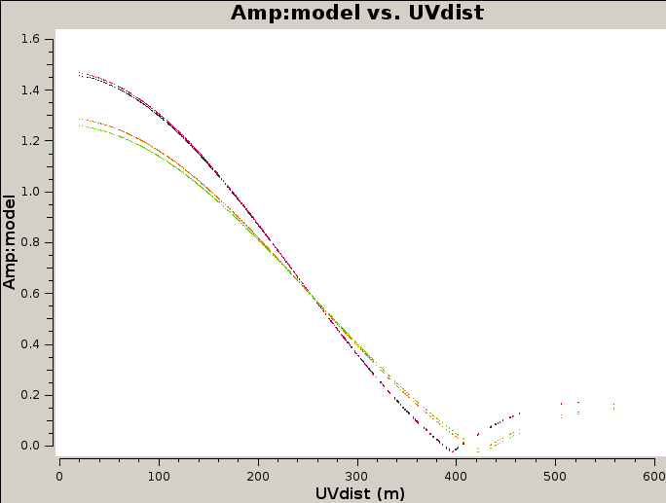
Flux scaling
The visibility amplitudes which come out of the correlator have an arbitrary scaling.
To convert these into physically meaningful values we observe a source of known flux to which we can “bootstrap” the amplitudes values to.
Calibrator needn’t be close to the source. (But should avoid being low in the sky).
CASA model of Titan for a given dataset
(Notice the y-axis scale)

Slide 27
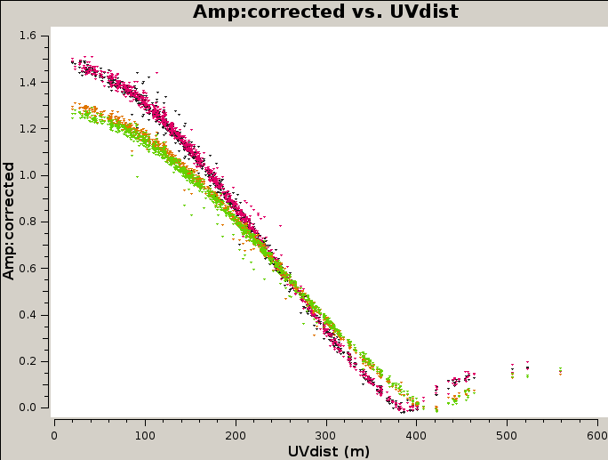
Flux scaling
This is typically a two part process, where by you set your amplitude scales with one task (e.g. setJy in CASA) and then scale the fluxes of other sources with another (e.g. fluxscale in CASA).
Fully calibrated data for Titan

Slide 28
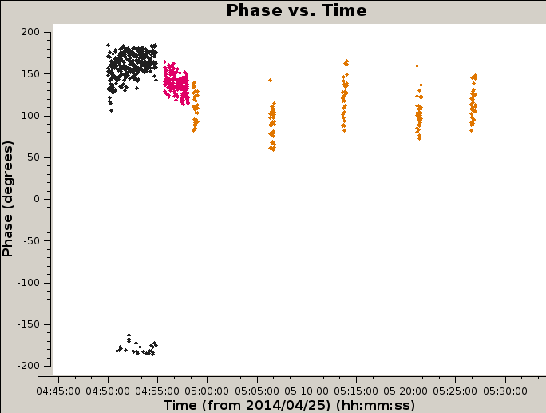
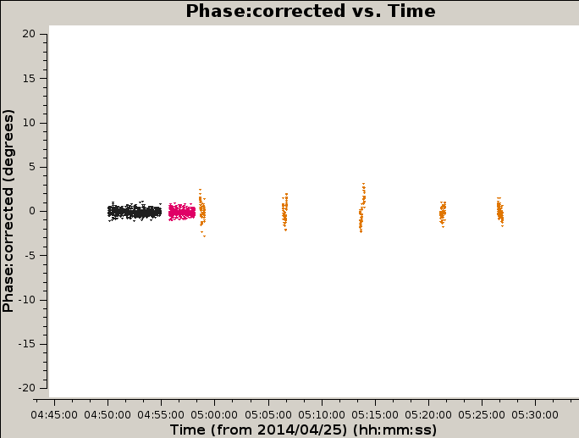
Complex Gain (Phase and Amplitude)
Calibration step to mitigate temporal effects (i.e. the atmosphere) on the phase and amplitude of the target source visibilities.
Target a bright, nearby (few degrees) quasar and intersperse throughout observation of target.
Needs to be nearby to be experiencing the same atmospheric conditions
Notice y-axis is factor 10 smaller!

Slide 29
Complex Gain (Phase and Amplitude)
Calibration step to mitigate temporal effects (i.e. the atmosphere) on the phase and amplitude of the target source visibilities.
Target a bright, nearby (few degrees) quasar and intersperse throughout observation of target.
Needs to be nearby to be experiencing the same atmospheric conditions
Notice y-axis is factor 10 smaller!
Scans on Science Target

Slide 30
Imaging and cleaning

Slide 31
What we measure (reminder)
Correlator output
Eq. 1
Visibility equation
Eq. 2
$$I^{D}\left(l,m\right)=\iint_{−∞}^{∞}{S\left(u,v\right)V\left(u,v\right)e^{2πi\left(ul+vm\right)}dudv}$$
Dirty image
Eq. 3
Notes:
The greater the number of UV points the greater our knowledge of I

Slide 32
Sampling function
Let us call the sampling of the uv-plane (aka uv-coverage), S, the sampling function
$$S\left(u,v\right)=\sum_{k=1}^{M}{δ\left(u−u_{k},v−v_{k}\right)}$$
Given this the synthesized beam, B, is B=FT(S ).
And for each uv-point we have an observed visibility, V(u,v), so we can define the sampled visibility function as:
$$V^{S}\left(u,v\right)≡\sum_{k=1}^{M}{δ\left(u−u_{k},v−v_{k}\right)}V(u_{k},v_{k})$$
So V ^{s}=SV and from earlier (eq. 3) I ^{D}= FT(V ^{S} ) = FT (SV ). From which it follows that I ^{D} is the measured sky brightness
convolved with the synthesis beam, B.
This is a truncated version of Chapter 7 (Briggs, Schwab & Sramek) of “Synthesis Imaging in Radio Astronomy II”

Slide 33
Weighting
Given this we can introduce weighting functions to control the shape of the synthesised beam.
DON’T WORRY TOO MUCH ABOUT THIS NOW, IT IS A SUBTLETY YOU NEED TO THINK ABOUT WHEN ACTUALLY IMAGING...
$$W\left(u,v\right)=\sum_{k=1}^{M}{R_{k}D_{k}T_{k}δ\left(u−u_{k},v−v_{k}\right)}$$
R_{k} = Weights relating to data quality, i.e. down weight bad data. This is observation dependent and we have no post observation control over it (so ignore).
T_{k} = Tapering function. Apply a tapering function (i.e. Gaussian), to the uv-coverage to for example downweight the outer uv-points lowering resolution.
D_{k} = Density weighting, applies some weight based on the clustering of uv points on a grid... This is the most commonly used type of weighting.
And as per the previous slide we can define the weighted and sampled visibility function as V ^{W}=WV.
This is a truncated version of Chapter 7 (Briggs, Schwab & Sramek) of “Synthesis Imaging in Radio Astronomy II”
Notes:
Where delta is assumed to be a dirac delta sampling.... Need to ensure tis remains true via observation set up. And k represents the kth visibility

Slide 34
Imaging the data
We now have the sampled and weighted visibilities, V ^{W}.
In order to efficiently make an image of our target sky brightness distribution, I, we need to take the Fourier transform of this using Fast Fourier Transforms (FFTs).
This requires the V ^{W} data to be gridded on to a regular grid.
This is done by convolution with some suitable gridding function*. Leaving us ultimately with some weighted and gridded visibilities which can be FFT’d to give us our dirty image I^{D}.
*Discussion of gridding algorithms is a little beyond the scope of this workshop, please check the references
at the start of this talk for more information.

Slide 35
CLEAN-ing
We’ve seen that our dirty image I^{D} is the sky brightness distribution convolved with the synthesised beam B.
To get a better representation of the sky brightness distribution we need to remove the artefacts introduced by B. To achieve this we use CLEAN*
*As far as I know CLEAN is not an acronym, but it is usually captialised. I don’t know why?!

Slide 36
Simple CLEAN overview
The Högbom (1974) CLEANing algorithm is the simplest CLEAN algorithm and is very illustrative of how CLEAN works
in general.
In words the Högbom algorithm works as follows:
Find the magnitude and position of peak emission in the dirty image.
Subtract from the dirty image the dirty beam, B, scaled by some gain value (i.e. 0.1). Creating a ‘residual’ image.
Note the position and magnitude subtracted as a point in a model.
Repeat 1-3 until a user defined threshold is reached, either some noise limit (in the residual) or a given number of iterations.
Convolve the final model with an idealised beam. I.e. a beam based on the interferometer if it was a huge single dish.
Or in a 2D example on the next page

Slide 37
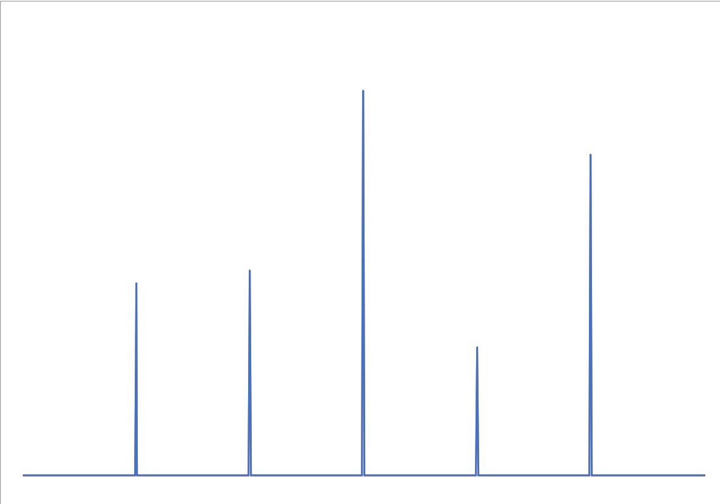
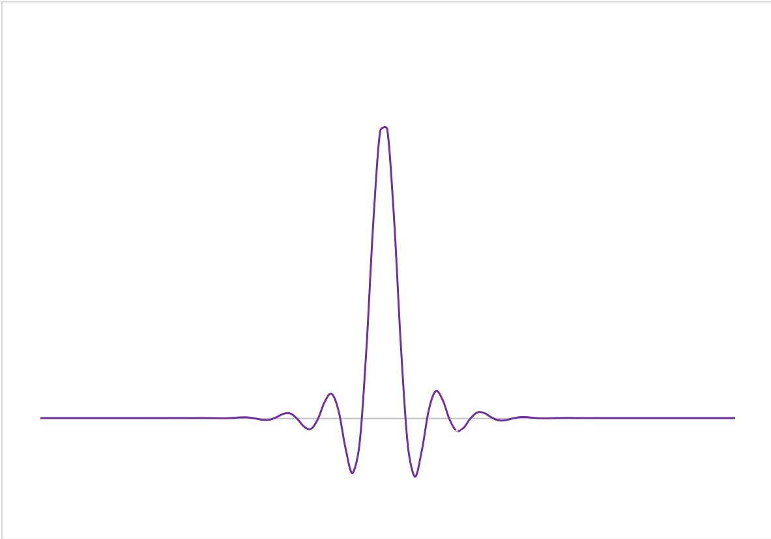
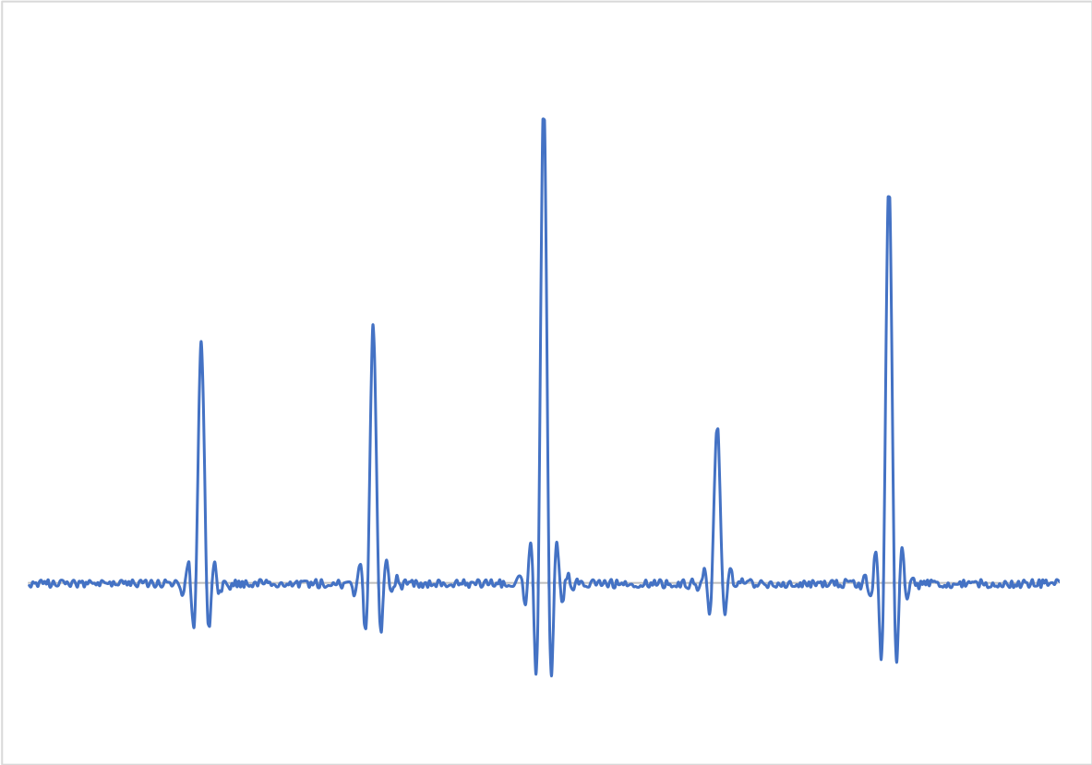
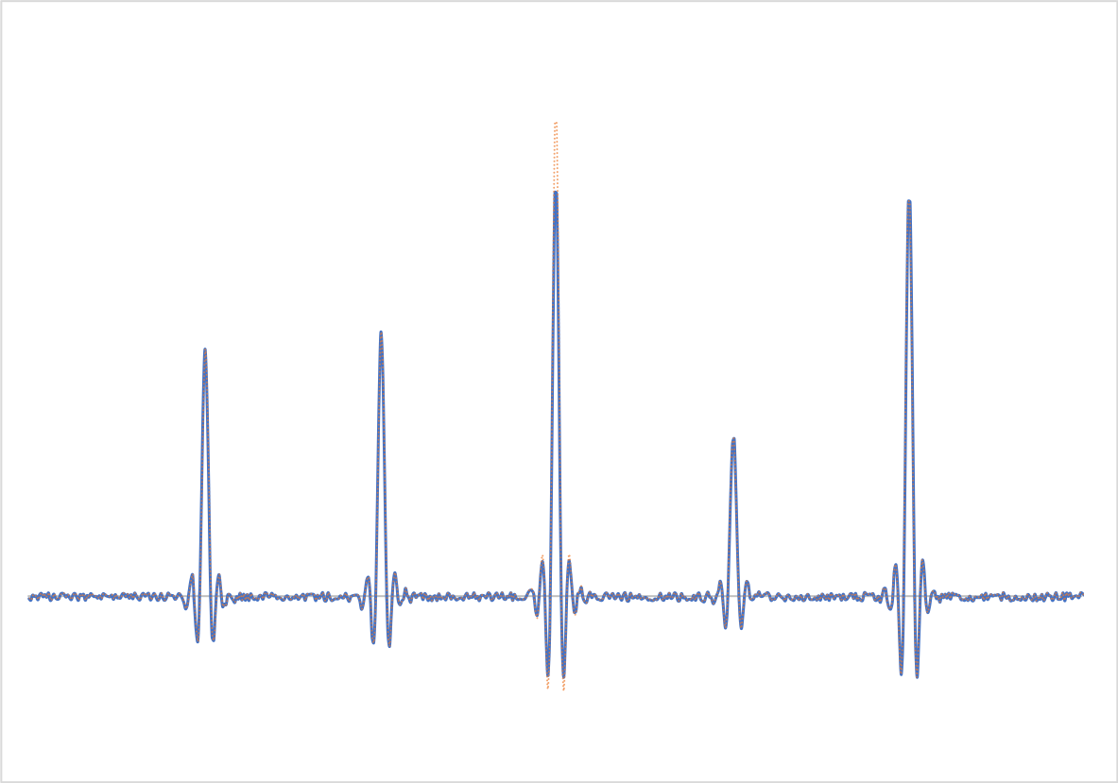
Högbom 2D example
*
True sky of 5 point sources
Dirty Beam (DB)
Dirty Image + noise, (DI)
Iteration 1
Residual Image after subtracting DB from peak in DI
CLEAN components in Model Image

Slide 38
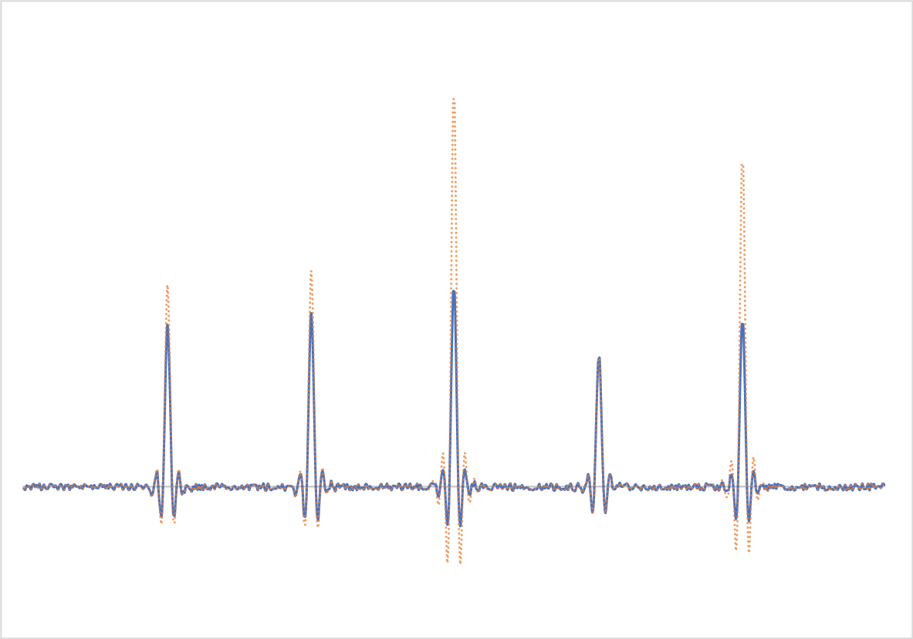
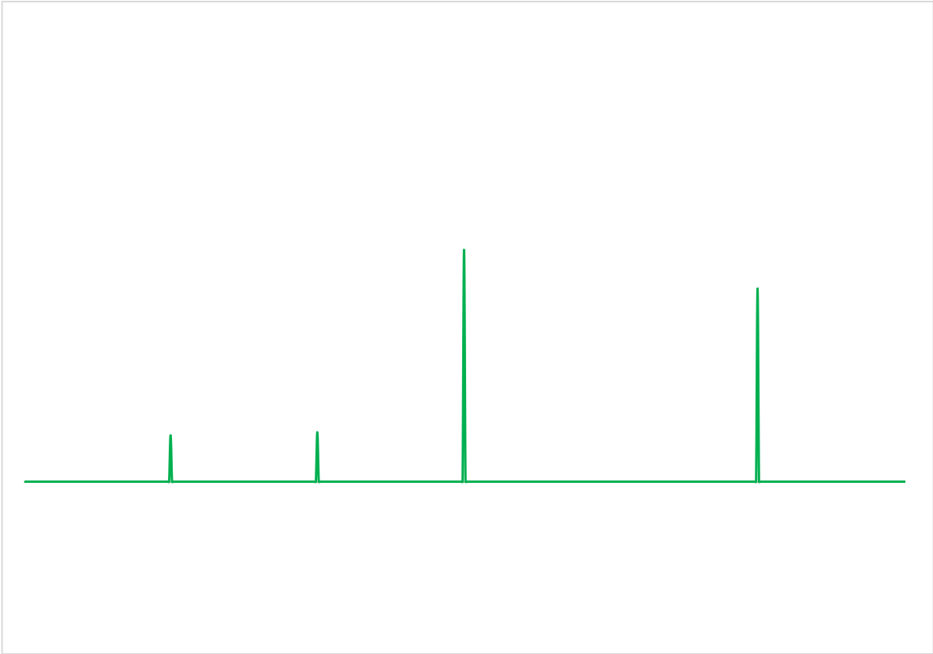
Högbom 2D example
*
True sky of 5 point sources
Dirty Beam (DB)
Dirty Image + noise, (DI)
Iteration n
Residual Image after subtracting several DBs from located
peaks in DI
CLEAN components in Model Image

Slide 39
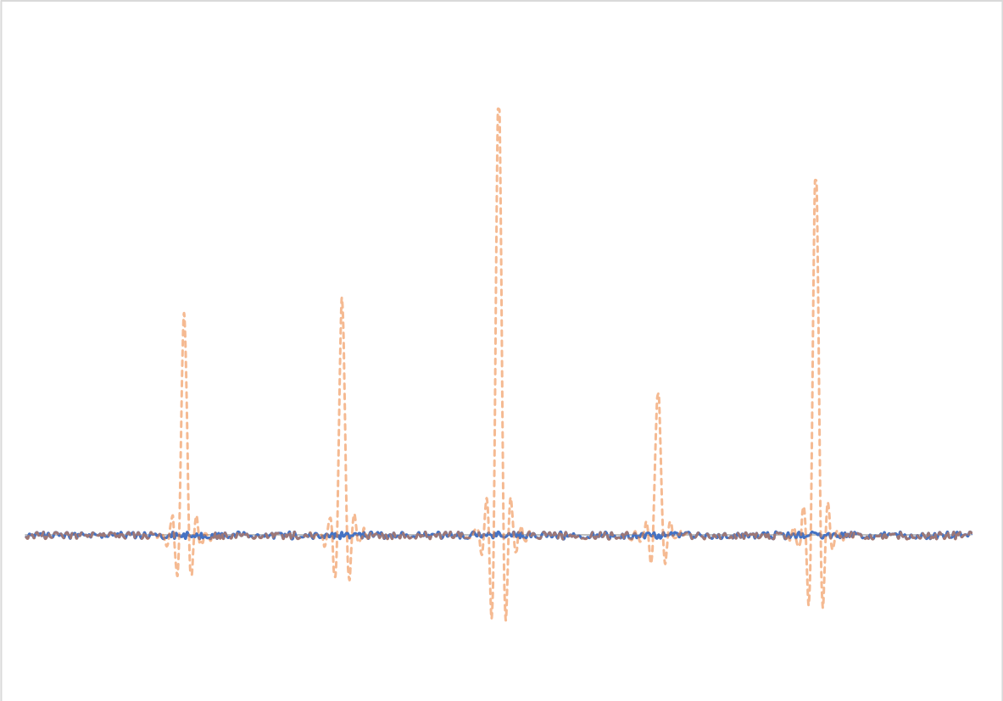
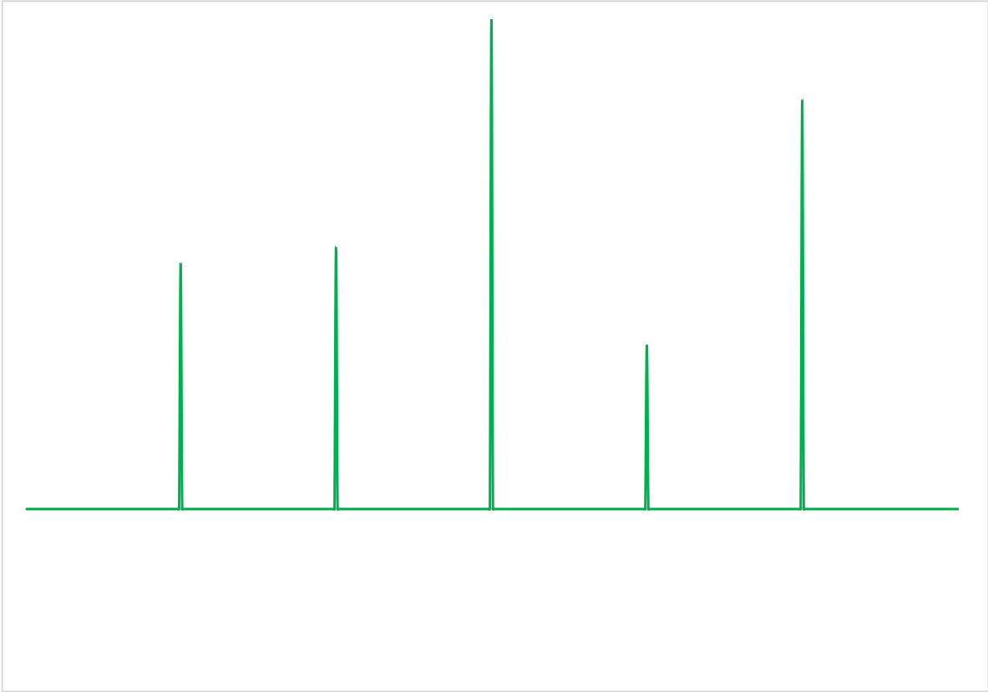
Högbom 2D example
*
True sky of 5 point sources
Dirty Beam (DB)
Dirty Image + noise, (DI)
Iteration FINAL
Residual Image after subtracting enough DBs from located peaks in DI until threshold met.
CLEAN components in model Image after final CLEAN
loop

Slide 40
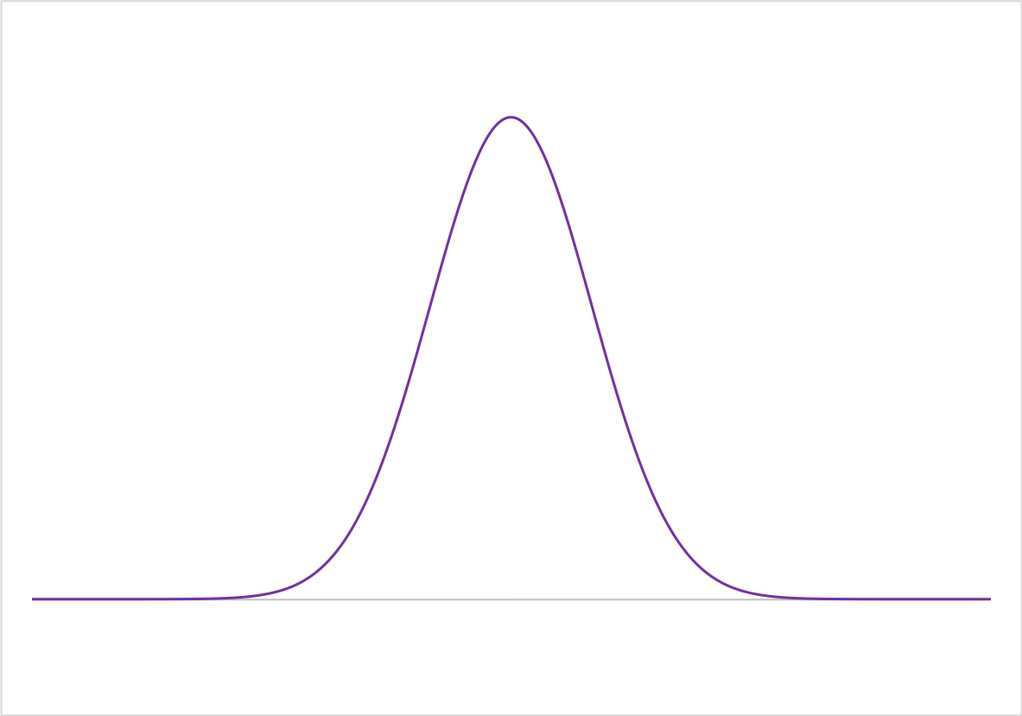
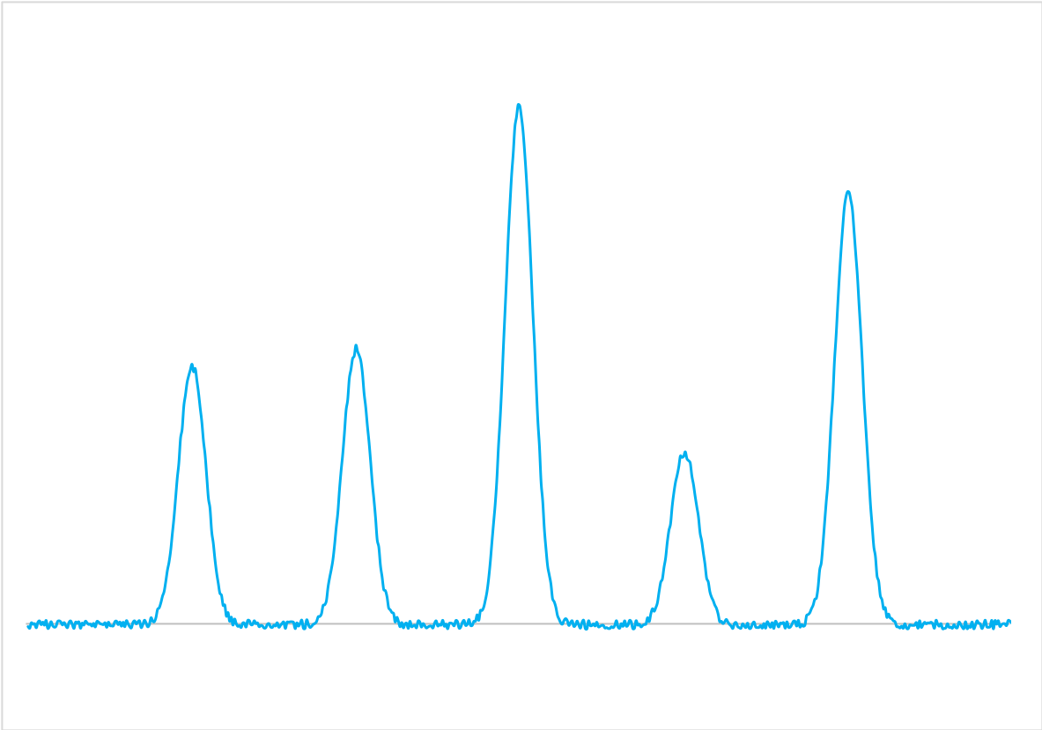
Högbom 2D example
*
CLEAN components in model Image after final
CLEAN loop
Idealized beam
Final reconstructed image

Slide 41
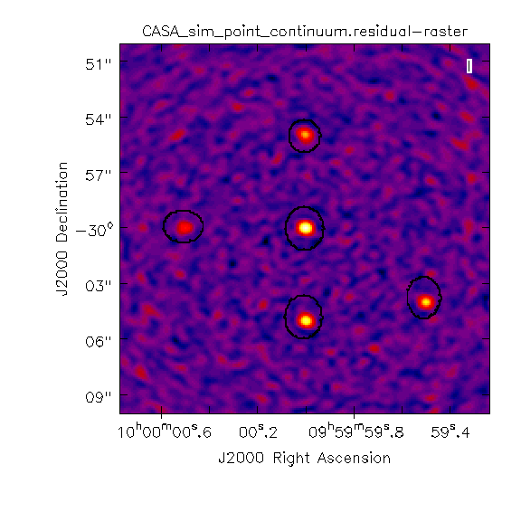
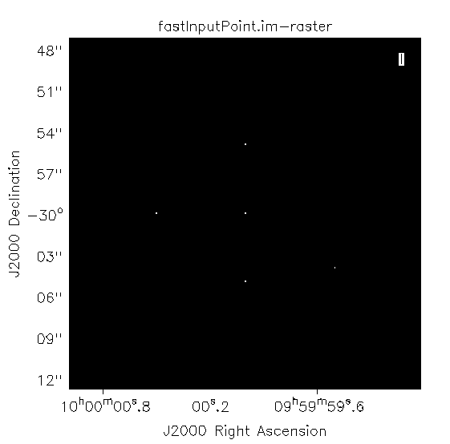
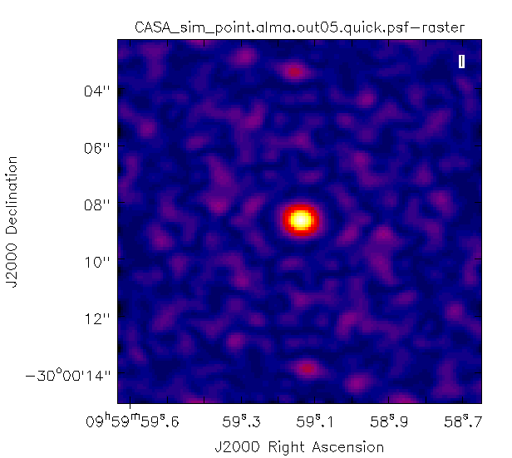
... and in 3D
*
True sky of 5 point sources
Dirty Beam (DB)
Dirty Image + noise, (DI)
→ Increasing CLEAN cycles →

Slide 42
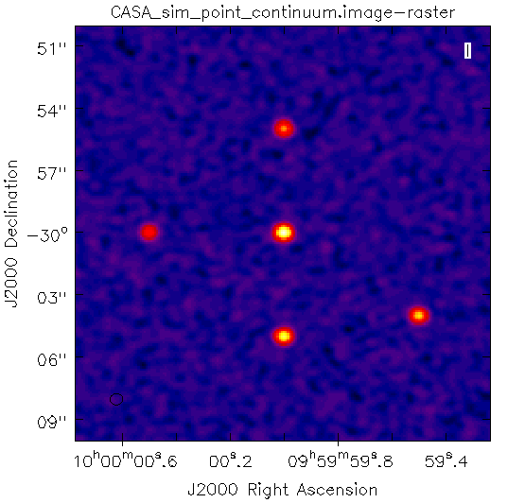
... and in 3D
*
True sky of 5 point sources
Dirty Beam (DB)
Dirty Image + noise, (DI)

Slide 43
And after all that you’ll have a nice image/data cube from which you can actually do some Science!

Slide 44
Which software to use?
Which telescope are you using?
ALMA
JVLA
eMerlin
EVN
GMRT
ATCA
SMA
Use Miriad
Use (EVIL) Miriad
Has your supervisor insisted you use AIPS?
Have you reminded your supervisor the year is 201x not 197x-199x?
YES
NO
Old MERLIN
Old VLA
Use CASA
YES
NO
Maybe use AIPS, but first try to...

Slide 45
Further Reading
The slides from this talk are based on the fundamentals of interferometry which are explained in detail across:
“Interferometry and Synthesis in Radio Astronomy” - Thompson, Moran & Swenson
“Synthesis Imaging in Radio Astronomy II” – NRAO
“An introduction to Radio Astronomy” – Burke and Graham-Smith (4th edition out soon Burke, Graham-Smith (& Wilkinson?))
“Tools of Radio Astronomy” – Wilson, Rohfls & Hüttemeister
“The CASA Cookbook” – Ott & Kern et al.

Slide 46
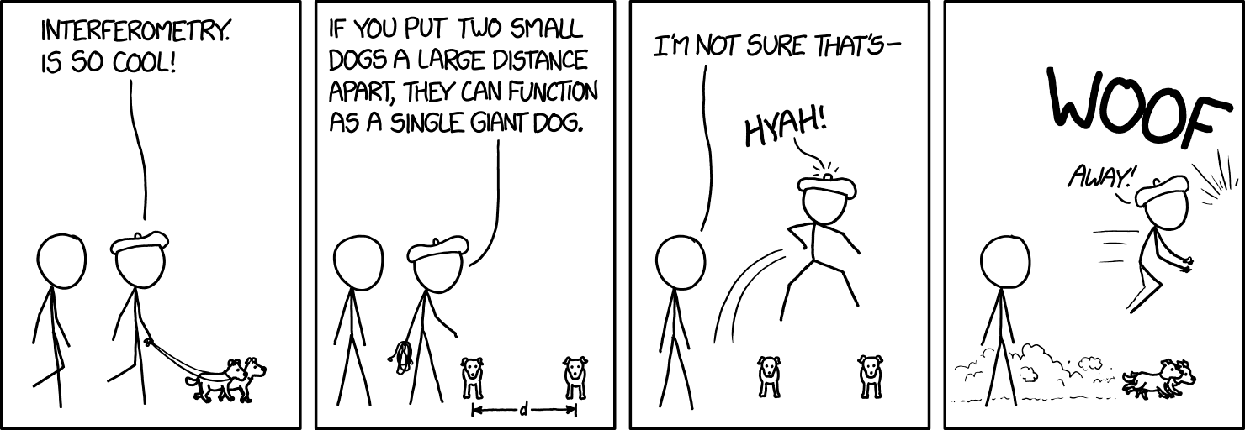
¡Cheers!
Credit - xkcd.com
¿Questions?

